Slide 1

1st National Conference on Sustainable Civil Engineering & Geospatial Technologies: Materials & Innovations for Climate Resilience (NCRT-SCE 2026) Buddha Institute of Technology GIDA, Gorakhpur Date of Conference: 15th – 16th April 2026
“Scour depth and local velocity fields impact the performance of bridge piers : Relevant for offshore or large bridges”
Under the Guidance
Mr. Baijnath Nishad
Assistant Professor
Presented By:
Arman khan
2205250000011
4th Year
Department of Civil Engineering, BIT Gorakhpur

Slide 2
Contents
Introduction
Problem Statement
Objectives
Literature Survey
Proposed Solution / Methodology
Results & Analysis
Conclusion & Future Work
Acknowledgements
References

Slide 3
Introduction
Background:
Scour is the removal of soil around bridge piers caused by flowing water, which weakens the foundation.
It commonly occurs in rivers and is a major concern in hydraulic engineering.
Understanding scour is essential for safe bridge construction.
Importance:
Scour is one of the leading causes of bridge failure worldwide. High flow velocity increases erosion and reduces structural stability.
Proper analysis helps in preventing accidents and economic loss.
Context:
Rapid infrastructure development requires safe and durable bridge design.
Studying local velocity and scour depth improves foundation performance.
This project focuses on analyzing their relationship for better safety.

Slide 4
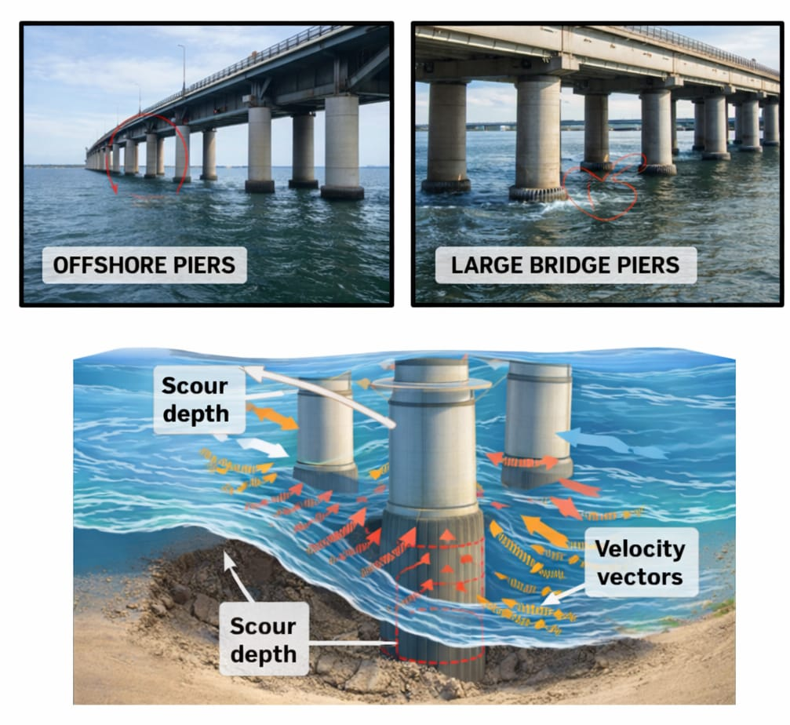
Fig. 1: Effect of Scour and Local Flow Fields on Offshore and Bridge Pier Stability

Slide 5
Problem Statement
Define the Problem:
Scour reduces the strength of bridge foundations.
It affects stability of the entire structure.
Improper design increases failure risk.
Why it matters:
Can cause bridge collapse and accidents.
Leads to economic loss and safety issues.
Affects long-term durability of structures
Current Gap:
Limited research on combined effect of parameters.
Lack of accurate prediction models.
Need for detailed analysis of velocity and scour.

Slide 6
Objectives
Objective 1:To study the scour depth around bridge piers under flowing water conditions.
Objective 2:To analyze the effect of local velocity on soil erosion and scour formation.
Objective 3:To improve the safety and design efficiency of bridge foundations.

Slide 7
Literature Survey
Author | Year | Journal / Source | Study Focus | Key Findings
Melville, B.W. | 1997 | Journal of Hydraulic Endineering | Bridge pier scour analysis | Developed equations to predict local scour depth around piers.
Richardson, E.V. | 2001 | Hydraulic Engineering Circular | Scour at bridge foundations | Identified scour as a major cause of bridge failure worldwide.
Raudkivi, A.J. | 1986 | Journal of Hydraulic Research | Flow pattern around piers | Found that vortices increase erosion near pier base.
Chiew, Y.M.. | 1992 | Journal of Hydraulic Engineering | Clear-water scour study | Showed that velocity strongly affects scour depth formation.
Dey, S. | 2014 | Advances in Water Resources | Sediment transport & scour | Provided advanced models for predicting scour under different conditions.

Slide 8
Proposed Solution / Methodology
Approach:
Experimental and analytical study of flow around bridge pier.
Observation of scour formation under different flow conditions.
Parametric analysis of velocity and scour depth relationship.
Techniques:
Measurement of local velocity near the pier.
Observation and recording of scour depth over time.
Comparative analysis for different flow velocities.
Tools:
Hydraulic flume setup (for water flow experiment).
Measuring scale / sensors for depth and velocity.
Data recording and analysis tools (Excel / graphs).

Slide 9
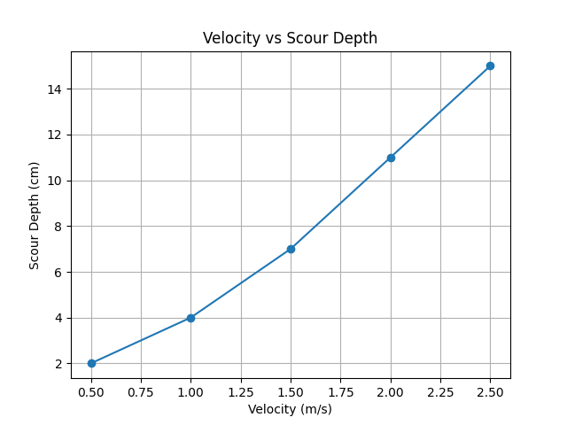
Results & Analysis
In order to study the effect of flow conditions on scour formation, observations were carried out by varying the water velocity around the bridge pier. The velocity range was gradually increased to analyze its impact on scour depth.
Based on the experimental observations, the scour depth was measured for different velocities. The variation of scour depth with flow velocity is represented graphically, showing a clear increasing trend.
It is observed that with an increase in velocity, the scour depth increases significantly. The maximum erosion occurs near the base of the pier due to the formation of vortices and turbulent flow.
FIG 2. Variation of scour depth with flow velocity around bridge pier.

Slide 10
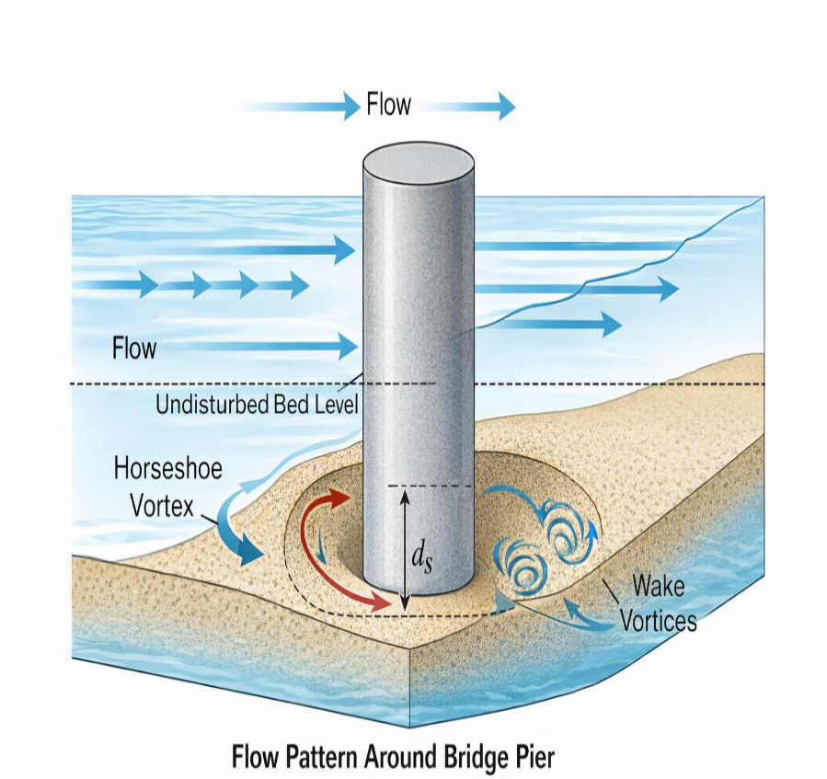
Variation of Scour Depth with
Flow Velocity:
The variation of scour depth with flow velocity is analyzed for different flow conditions.
It is observed that as velocity increases, the scour depth also increases significantly.
Maximum scour occurs near the base of the pier due to vortex formation and turbulence.
FIG 3. Variation of Scour Depth with Flow Velocity around Bridge Pier

Slide 11
Conclusion & Future Work
Summary:
Source depth increases with increase in flow velocity around the bridge pier.
Maximum erosion occurs near the base due to vortex formation.
Local flow behavior plays a key role in foundation stability.
Proper design and analysis can reduce the risk of bridge failure.
Key takeaway :
Scour is a major factor affecting the safety of bridge foundations.
Increase in flow velocity leads to higher scour depth and erosion.
Proper analysis and design can prevent structural failure.

Slide 12
Cont…
Future Work :
Study can be extended under flood and extreme flow conditions.
Different soil types and pier shapes can be analyzed.
Advanced numerical and simulation methods can be used.
3D modelling can provide more accurate and detailed results.

Slide 13
Acknowledgements
Guide:
I would like to express my sincere and heartfelt gratitude to my respected guide Mr. Baijnath Nishad, Assistant Professor & Head of Department, Department of Civil Engineering, for his constant guidance, valuable suggestions, motivation, and continuous support throughout the completion of this research work. His technical expertise and encouragement helped me in successfully completing this study.
Institution:
I would also like to express my sincere thanks to Buddha Institute of Technology, Gorakhpur for providing a supportive academic environment, necessary resources, and infrastructure facilities which made this research work possible. I am also thankful to the Department of Civil Engineering for their cooperation and support.

Slide 14
References
Melville, B. W. (1997). Pier and abutment scour: Integrated approach. Journal of Hydraulic Engineering, 123(2), 125–136. https://doi.org/10.1061/(ASCE)0733-9429(1997)123:2(125)
Richardson, E. V., & Davis, S. R. (2001). Evaluating scour at bridges. Hydraulic Engineering Circular No. 18 (HEC-18). Federal Highway Administration, Washington, D.C.
Raudkivi, A. J. (1986). Functional trends of scour at bridge piers. Journal of Hydraulic Research, 24(1), 23–36. https://doi.org/10.1080/00221688609499317
Chiew, Y. M. (1992). Scour protection at bridge piers. Journal of Hydraulic Engineering, 118(9), 1260–1269. https://doi.org/10.1061/(ASCE)0733-9429(1992)118:9(1260)
Dey, S. (2014). Fluvial hydrodynamics and scour. Advances in Water Resources, 62, 95–119. https://doi.org/10.1016/j.advwatres.2013.09.013

Slide 15
Thank You

